Slide 1
PROJECT REPORT: PDF Cracker Tool Using Python(GUI Based)
Submitted by: Shradha Garg
Course: B.Tech (Computer Science)
Internship Organization: Inlighn Tech
Date: 21 June 2025

Slide 2
Objective : To develop a Python-based tool with a graphical interface that attempts to unlock password-protected PDF files using a given wordlist. The goal is to simulate a dictionary-based cracking method, commonly used in cybersecurity, for ethical learning purposes.

Slide 3
Technologies Used :
Python 3
tkinter (for GUI development)
PyPDF2 (for PDF handling and decryption)
File handling and basic loops

Slide 4
GUI Features :
Select a protected PDF file using "Browse PDF"
Load a wordlist file (.txt) containing possible passwords
Click "Crack PDF" to attempt unlocking
Shows success message if password is found
Displays failure message if password is not in the wordlist

Slide 5
PROJECT LOGIC :
Read the password-protected PDF file using PyPDF2
Read each password line-by-line from the wordlist
Try to decrypt the PDF using each password
If decryption succeeds, show password and save unlocked PDF
If none match, show "password not found" alert

Slide 6
Realistic Cracking Simulation :
This tool uses the same method as ethical hacking tools: dictionary attack.
Cracking result depends on the quality and correctness of the wordlist.
->Not every password is guaranteed to be cracked — that’s part of the realism.

Slide 7
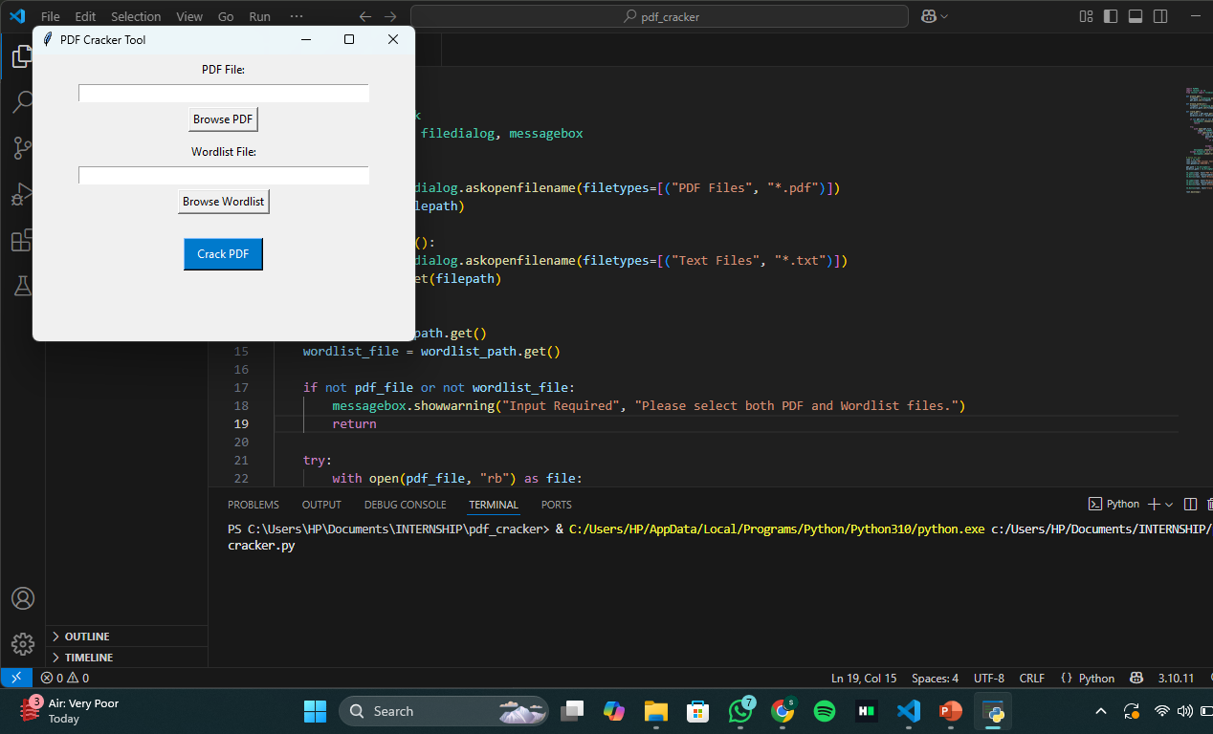
GUI SCREENSHOT :

Slide 8
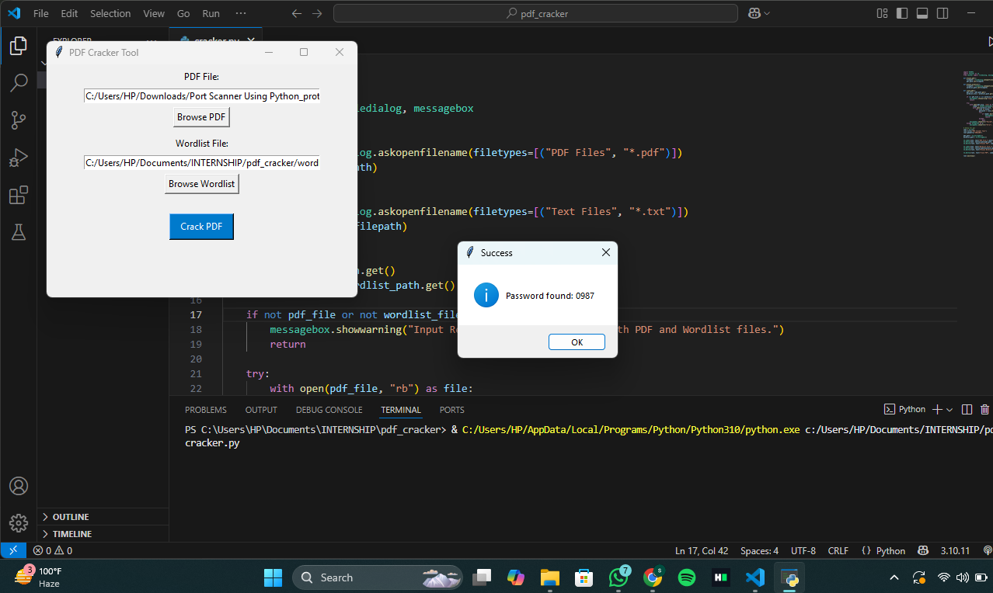
OUTPUT Screenshot showing “Password Found” (SUCCESS)

Slide 9
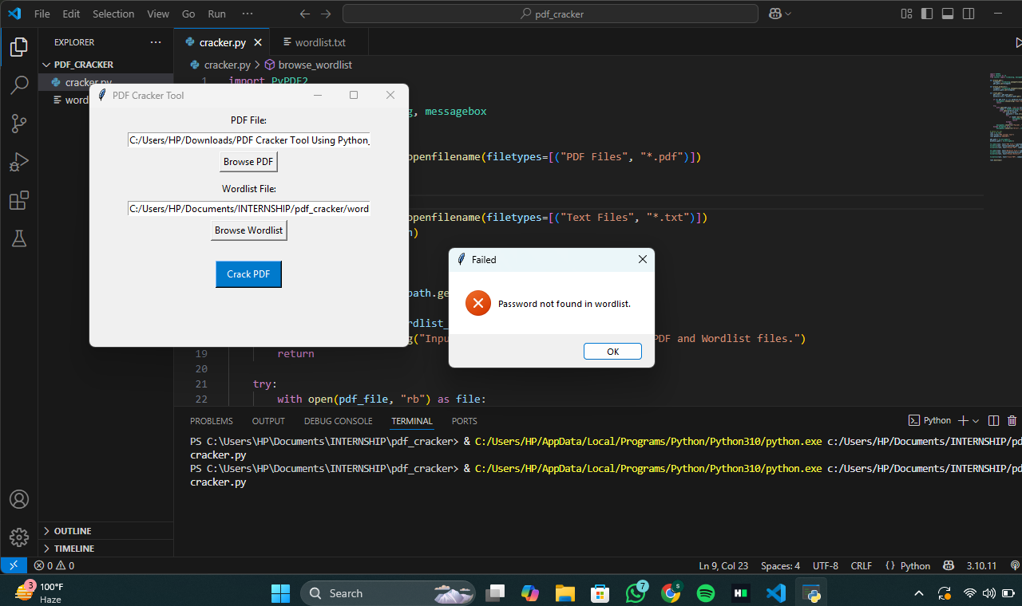
OUTPUT Screenshot showing “Password not found” (FAILURE)

Slide 10
Conclusion : The project demonstrates the implementation of a GUI-based dictionary attack on password-protected PDF files. It successfully shows how ethical tools attempt to unlock documents and how success depends on the password being in the wordlist. Both success and failure outcomes are part of real-world use.

Slide 11
THANK YOU

